Slide 1
Sensory and Physical Needs
Parent workshop
Quick Checker for Physical and Sensory needs
Sensory and physical Areas of concern…
the pupil presents with having a visual impairment which is affecting their learning and/or access to the curriculum e.g. holds books very closely or at an unusual angle, fails to respond to non-verbal instructions, loses place when reading, skips lines and struggles to find text on a page
the pupil present with having a hearing impairment which is affecting their learning and/or access to the curriculum e.g. distractible in class, poor listening skills in a busy environment, asks you to repeat instructions
the pupil presents with poor speech intelligibility, difficulty with recognising and responding to phonics, chooses to either avoid attention or is over demanding, limited vocabulary both receptive and expressive, immature grammatical structures in spoken language
the pupil presents with having a multi-sensory need which is affecting their learning and/or access to the curriculum e.g. have a dual sensory loss where both vision and hearing are recued
the pupil’s physical skills/needs are affecting their learning and/or access to the curriculum
the pupil’s medical needs are affecting their learning and/or access to the curriculum

Slide 2
Attention Deficit Hyperactivity Disorder
ADHD is a neurodevelopmental condition affecting 5% of the UK population. The three main features of the symptomology of ADHD are Inattention, Hyperactivity and Impulsivity. However, not all children and young people with ADHD will experience challenges in all of these areas.
Click below to see how the NHS defines ADHD and their guidance:
www.nhs.uk/conditions/attention-deficit-hyperactivity-disorder-adhd/
Referrals
Sensory Processing and Gross motor skills difficulties – Referrals can be made through school to the Occupational Therapy team.
Parents can also complete their own referral through Children and Family Health Devon
http://childrenandfamilyhealthdevon.nhs.uk
For ADHD referrals you need to go through your doctor. School will then support the referral by completing a school questionnaire (requested by paediatrician) to say what behaviours the child is displaying in school.

Slide 3
Hyperactivity
Lots of physical energy and movement, for example, fidgeting, rocking, turning on chair.
Leaves chair when expected to remain seated.
For younger children, running about and climbing on things when it is inappropriate to do so.
Excessive talk.
Impulsivity
Blurts out answers prematurely. -Cannot wait. -Interrupts or intrudes on other’s activities.
Tasks that require stillness are challenging.
Bouts of undirected energy followed by periods of indolence or tiredness.
Inattention
Doesn’t pay attention to details. -Maintaining and sustaining attention on activities to their completion. -High levels of distractibility. -Doesn’t seem to be listening when spoken to directly. -Difficulties remembering and following instructions.
Forgets elements of a task.
Strategies used in School to support Sensory processing and ADHD Sensory breaks -Fidget toys -Wobble cushion Ear defenders -Learning broken down into smaller chunks Organisational strategies – e.g. visual timetables Fine motor skills activities

Slide 4
Our 8 Senses
Tactile (light and deep touch)
Visual (sight)
Gustatory (Taste)
Olfactory (Smell)
Auditory (Sound)
Plus 3 more….
Proprioception – processes sensations from our joints, muscles and connective tissues. It helps us to know where each body part is and how it is moving (body awareness)
Vestibular - helps us to know our head position and where our body is in space. It tells us whether the movement is fast, slow, up, down or angular.
Interoception – internal sensory system around physical and emotional states. Eg: hunger, being tired.

Slide 5
Sensory Processing
Our senses give us the information we need to function in the world.
Receive information from stimuli both outside and inside our bodies.
Every sound we hear, move we make, object we touch produces sensations. It is important to recognise that sensory information can have an impact on how we feel, how we think and how we behave or respond.
This can result in:
- sensory seeking to make us feel better
- retreating or avoiding sensory information if it makes us
feel overwhelmed.

Slide 6
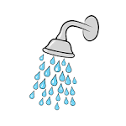
Feeling Just Right
Throughout the day we all have times when we need to wake ourselves up, or calm ourselves down.
We do all kinds of things to help us feel “Just Right”
When we are feeling in a ‘just right state’ we are better able to function and feel comfortable, which makes challenges easier to deal with.
Environments
Anyone can be stimulated positively or negatively just by the environment around them e.g light can be too bright, the room too noisy, the glare of the sun too dazzling.
It is important to consider the environment and what could be done to reduce possible trigger stresses and enhance positive experiences. Sometimes we may be able to modify the environment and other times we may be able to use sensory strategies to cope with challenges.

Slide 7
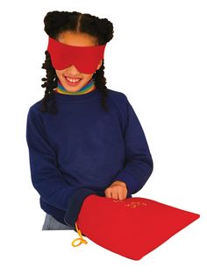
Tactile System Overview
Tactile information is processed through sensory receptors located in the skin. It provides us with information about touch sensations: pressure, vibration, movement, temperature and pain.
Two components: the protective (or defensive) system - causes the receptors to respond, alerting us to potentially harmful stimuli.
The discriminative system (deep touch) tells us what we are touching, where on our bodies it is touching us, the size, shape and texture, it also detects vibration. It helps us to know when we are touching something and for how long it is touching us.

Slide 8
Over-responsive
Difficulties with having hair wash and brushed
nails cut
Withdraw from situations
eg getting dressed, playground, unfamiliar settings.
Overreact to physically painful experiences
Fuss about clothing types.
May prefer short sleeves and shorts, even in winter OR prefer long sleeves even in summer to avoid having skin exposed
Avoidance of messy play activities.

Slide 9
Under responsive
Craves extra stimulation
No reaction to pain
Unaware of messiness around the mouth / nose.
Drop things without realising
Holds pencil too tightly
Licking or mouthing objects
Hurts other children or pets during play, seemingly without remorse.
Touches everything

Slide 10
Strategies
Finding appropriate activities for the sensations the child is seeking, and give them opportunities for more input. Such as, increased opportunities for tactile exploration or movement activities.
Proprioceptive activities - this is any movement with weight or resistance against the body.
Increasing proprioception helps regulate the sensory system, so the body is calmer and more organised. This means that the system can register and make sense of sensory input.
Deep touch pressure acts as a calming or focusing agent on the nervous system eg increases endorphin levels and decreases heart rate and blood pressure (indicators of anxiety and stress)
It is often provided by firm holding, firm stroking, hugging and squeezing.
When touch is uncomfortable use deep touch to desensitise the area.
Use proprioceptive activities prior to and following the particular activity.
(Hsin-Yung Chen et. al., 2011).

Slide 11
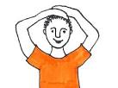
Calming Demonstration and Trial
It is important to remember that one activity may benefit one child but not another and its effectiveness may vary throughout the day. An activity that may be calming for one child may be alerting for another.
Wrap self in a big, heavy blanket.
Hands on head and pressing down.
Tucking legs up and squeezing.
Joint compression
Slow rocking e.g. rocking chair.
Giving themselves a hug.
Squeezing and relaxing a small fidget toy.
Squeezing and relaxing face and/or hands.
Snuggling into a small space.
Chewing food or chew toys
Sucking yoghurt/thick milkshake through straw.

Slide 12
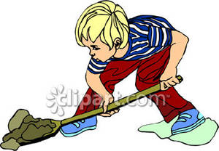
Continued…
Calming
Routine calming activities may be part of the day and
part of the daily timetable
Walk to school with a backpack on.
Press ups or chair press ups regularly through the day e.g. before school, lunch time, after school.
Help with moving chairs/furniture in classroom.
Help to open and hold doors, or collect and hand out equipment.
Put on a heavy coat or heavy blanket over the shoulders as part of chill out time.
Have a corner with favourite sensory activities to go to
Squeeze/rock against gym ball

Slide 13
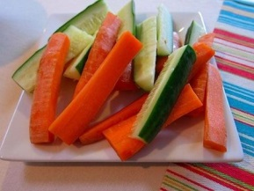
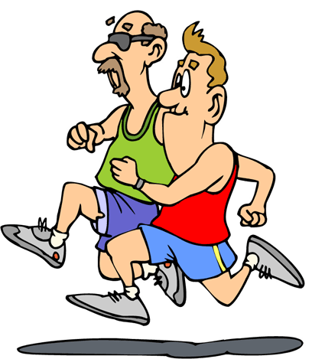
Alerting
Up/down movements, jogging/running, fast movement (for short periods only).
Jumping, jumping jacks.
Clapping activities.
Making faces e.g. open mouth wide.
Stamping on spot.
Eating crunchy food.
Drinking cold drinks
Regular routine of jumping/chair push ups.
Timetable the ‘Quick Fix’ that works into regular routine, immediately before the young person has to pay attention to a task.

Slide 14
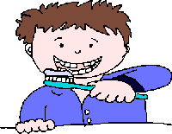
Self care
Performing self care tasks requires complex processes – sequencing of activity, body awareness and adequate attention levels
Need to tolerate and overcome potential sensory sensitivities such as the feel of water in the shower, or the feel of a towel, noise of others eating.
Strategies to support:
Establish a routine and consistent expectations
Write it down - Visual or written prompts; Picture sequencing; Visual timetables
Break tasks into achievable steps
Backward and forward chaining
Practice
Keep calm

Slide 15
Using sensory activities to help regulate and minimise outbursts
Those with sensory or communication difficulties can find it harder to regulate and express their emotions.
Strategies to support:
Preventing rather than reacting
Building proprioceptive activities into daily routine so that levels aren’t building up throughout the day.
Building in space and quiet time, where there aren’t demands on the young person. If they can’t manage an unstructured time then give them a choice of activity.
Identifying in advance what might help them let out their frustrations
Using emotion cards for them to explain how they are feeling
Look for acceptable and safe ways to release. Physical activity, hitting a cushion, trampoline, punch bag, squeezing a big cushion or soft toy.

