Slide 1
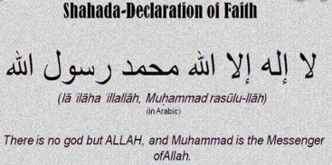
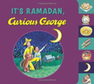
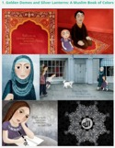
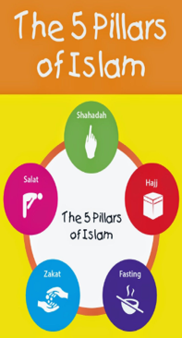
Being a Muslim: KS1 Knowledge Mat (1.6 Y2)
Subject Specific Vocabulary |  |  | Exciting Books
Muslim | A person who follows the religion of Islam.
Allah | The Arabic term for “God.”
Mosque | A special building where Muslims worship.
Muhammad (Peace be upon him/PBUH) | The final prophet to whom Muslims believe God revealed the Qur’an. | Sticky Knowledge- Who is a Muslim and how do they live?
Shahada | A statement of faith that all Muslims recite. The first of the 5 Pillars. | The Shahadah is very important for Muslims. It is recited (said) by Muslims to declare (show) that they are committed to Allah.
Messenger | Someone who delivers a message. | Muslims believe that there is only one God referred to as Tawhid. Muhammad (Peace Be Upon Him/PBUH) is his messenger.
Tawhid | Arabic for “declaring one god”. Muslims believe that there is only one God. | Muslims learn a lot from the Prophet Muhammad (PBUH) through stories such as the ‘Tiny Ants’ (care for all of Allah’s creation and ‘The Prophet Muhammad and the black stone’ (being wise).
Qur’an | The Holy Book of Islam. | Muslims have 99 names for Allah, such as ‘All Compassionate, The Pure One and the Source of Peace’.
Prophet | A person Muslims believe was chosen by God to teach people about Allah’s message. | Muhammad received the Holy Qur’an on the ‘Night of Power’. Muslims treat the Qur’an with the upmost respect by wrapping it up.

