Slide 1

Supporting Children with Social, Emotional and Mental Health Difficulties (SEMH) at
The Grove School
*SENDCo Team Presentation 25th March 2024

Slide 2
What are SEMH difficulties?
Social, Emotional and Mental Health Difficulties
Children may experience a wide range of social and emotional difficulties which manifest themselves in many ways. These may include becoming withdrawn or isolated, as well as displaying challenging, disruptive or disturbing behaviour. These behaviours may reflect underlying mental health difficulties such as anxiety or depression, self-harming, substance misuse, eating disorders or physical symptoms that are medically unexplained.
Other children may have disorders such as attention deficit disorder, attention deficit hyperactive disorder or attachment disorder.
Social, Emotional and Mental Health Difficulties include:
ADD
ADHD
Attachment Disorder
(The Grove School SEND Policy)

Slide 3
How do we help pupils with SEMH difficulties?
Universal Provision – | Social, emotional and mental health This SEND inclusive approach is available in our class all the time for which ever children need it
Learning Environment Toolkit | Class agreement/charter Social and emotional development e.g. buddy systems, friendship strategies, 5-point scale (1 being low 5 being feeling great)/ feelings display, Worry box or worry monster Social seating and proximity to the teacher Identified safe spaces for calming down Time out systems Class timetable for the day
Teacher Toolkit | Opportunities to develop social development, interaction and promote positive peer relationships Structured routines, including regular whole-class circle time Use of choice and motivation Calming strategies Tune in to signs of dysregulation - offering movement breaks, pre-empt difficult situations and plan accordingly
Pupil Toolkit | Visual timetable (now, next)
The Grove School Intervention strategies | Social group sessions Friendship links Social stories Lola the therapy school dog
External Agencies | GP or Paediatrician CAMHs Support

Slide 4
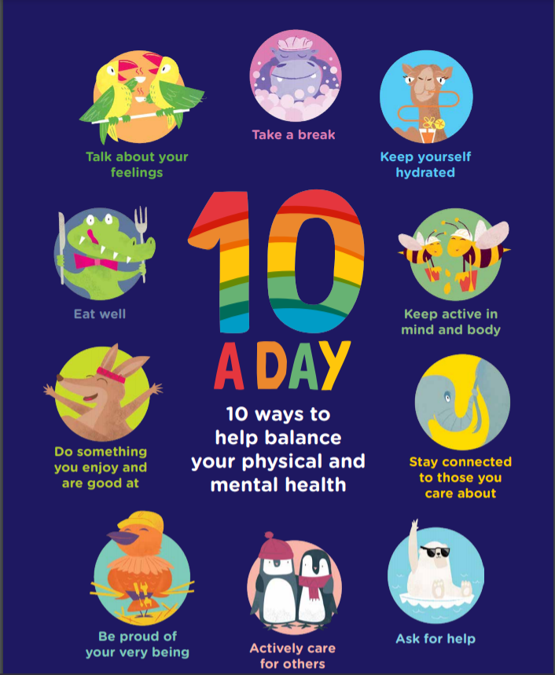

Slide 5
The Early Help Process
What is Early Help?
Early Help is an integral part of everyone’s role.
It is the initial response offered by all services in contact with children, young people and families when they need extra support to thrive.
It’s not a specific service or team. It’s an approach to working that brings together people from a range of different services and teams who will work with the whole family to help improve things for everyone.
The aim is to identify and build on a family’s strengths to help them resolve their own difficulties and support them to develop skills to prevent further problems and better manage any future challenges
https://www.devonscp.org.uk/early-help/early-help-information-for-workers/a-one-minute-guide-to-early-help-in-devon/

Slide 6
Early Help Assessment Areas:
Getting a Good Education, Including Poor Attendance, Suspensions /Not in School, Special Educational Needs Not Being Met
Good Early Years Development
Physical and Mental Health
Promoting Recovery and Reducing Harm from Substance Use
Improve Family Relationships
Children Safe from Abuse and Exploitation
Crime Prevention and Tackling Crime
Safe from Domestic Abuse
Secure Housing
Financial Stability

Slide 7
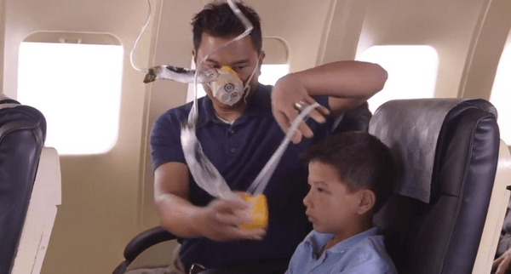
How can Parents help their child with SEMH difficulties?
https://www.qwell.io/video
https://childrenandfamilyhealthdevon.nhs.uk/lumi-nova/
https://www.kooth.com/#

Slide 8
NHS Help for Children with SEMH:
Child and Adolescent Mental Health Services (CAMHS) are services that support young people experiencing poor mental health, or difficult feelings or experiences. CAMHS can work with schools, charities and local authorities.
Will CAMHS accept a referral and help my child?
https://childrenandfamilyhealthdevon.nhs.uk/camhs/professional/professional-support/request-criteria-camhs/

Slide 9
Any other questions
?
Our contact email address is
sendco@the-grove-primary.devon.sch.uk

