Slide 1
SEND Identification and Processes at The Grove

Slide 2
Notes:
Explain that this Equity is what we hope to achive at the grove, inclusion in class

Slide 3
Definitions:
Special needs (SEND): A child has special educational needs if they have a learning difficulty or disability that makes it more difficult for them to learn than most children their age. Special educational needs are categorised into four main areas; communication and interaction, cognition and learning, social, emotional and mental health and sensory and physical needs. Parents can get help and advice from specialists, teachers and voluntary organisations.
SENDCo: This is the school’s special Educational Needs and Disabilities Coordinator. We have three at The Grove: Tonya Stirrup, Alison Caldwell and Jo Counter. Between them they work 5 days a week. On days when they are not in work the Head teacher will pick up urgent enquiries.
Special needs register: A school holds a register of the children it has agreed have Special Educational Needs. This register is not published. Children can come on and off the register at any time. Parents will be informed of whether their child have moved on or off the register by the SENDCo. A child may have one or more types of special needs recognised by the school. Children can be on the school’s ‘on-watch’ list when we are monitoring children who may potentially show a special need, parents aren’t necessarily informed of this stage as this is just part of the school monitoring processes we perform for every child.
Parent Consultations: These are formal meetings but which only occur between the school and the parent/carers and no other professional are involved. They occur twice a year between parents and the class teacher but can also occur due to additional needs of the child. We would generally ask at least two school professionals to attend these around SEND or Social needs and parents can bring additional support if they wish. These do not have minutes taken but notes are made of the main points. Parents have the opportunity to meet with a SENDCo at least 3 x a year.
Notes:
Tonya

Slide 4
Definitions:
Education Health and Care Plan (EHCP): An EHCP is a statutory assessment conducted by the local authority. It becomes a legal document which can support a child’s education from 0-25 years. The assessment process takes up to 20 weeks and a number of professionals are involved in making a decision if an EHCP will be issued. Schools and parents have to provide sufficient evidence (over at least two terms) that the child has a high level of need and despite the school having taken relevant and purposeful action to identify, assess and meet the Special Educational Needs and/or Disability of the pupil, the child has not made expected progress. EHCP’s come with some additional funding to support the child in school depending on need but this is often very minimal and does not support the school in providing 1:1 support for the child. The EHCP targets will be reviewed annually with the SENDCo and class teacher and additional professionals if involved.
Early Help: When a child or young person/family needs something extra, Early Help is the initial response offered by all services in contact with children, young people and families in order to prevent situations from getting more difficult. The Early Help Assessment is the tool used by all practitioners in Devon to assess the needs of the family. It enables information to be gathered about a family from a range of practitioners so their needs can be understood and the right support can be put in place.
TAF Meeting: A Team Around the Child/Family is a network of practitioners from school, and outside school, who work together to agree a plan and delivery of support to meet a child’s assessed needs and to some extent the needs of the family where these impact on the child or young person. They work directly with the family. Notes are taken.
Notes:
Jo -EHCP – Make point these are rare, nationally 4.3% pupils (13% pupils nationally are SEN support – therefore 17.3% all together on SEN register)
EH –This is primarily a process where parents are empowered to take action/make changes with challenges affecting their family
TAF meetings – An action planning cycle where parents lead intervention on making positive changes to their family situation (with support from professionals)

Slide 5
Initial stages of SEND Identification
If the teacher/parents have concerns about their child’s learning, communication or behavioural needs they will complete a SEND referral form which will be given to the SENDco team.
The SENDco team will then use this form to assess, observe and make a decision as to whether the child should be added to the ‘on watch’ list or SEND register and whether any additional actions need to be completed at this stage.
This is the start of the graduated response process (assess, plan, review, do cycle) – this is the school’s response to the child’s additional needs.

Slide 6
Initial stages of SEND Identification
If the teacher/parents have concerns about their child’s learning, communication or behavioural needs they will complete a SEND referral form which will be given to the SENDCo team.
The SENDCo team will then use this form to assess, observe and make a decision as to whether the child should be added to the ‘on watch’ list or SEND register and whether any additional actions need to be completed at this stage.
This is the start of the graduated response process (assess, plan, review, do cycle) – this is the school’s response to the child’s additional needs.
Notes:
Alison

Slide 7
What is included on the SEN referral form?
Date of referral
Assessment data – the reading, writing, maths levels and how far behind the child may be in relation to age related expectations
An outline of concerns/difficulties noticed by class teacher/parent
Teachers go through the quick needs checklist, ticking areas of concern under the different areas of SEN need
The teacher lists the provision already provided/tried to support the child’s needs under universal provision (quality first teaching)
Discussions with and opinions/concerns of parents are also recorded
The SENDCo then records the agreed actions to be taken
Notes:
Tonya

Slide 8
Quick Needs Checklist
There are four types of Special Educational Needs and Disabilities (SEND), as defined by the Department for Education:
Communication and Interaction.
Cognition and Learning.
Social, Mental and Emotional Health.
Sensory or Physical.
The Quick Needs Checklist provide the teachers and SENDCo with a way of identifying the main areas of need.
Notes:
Tonya

Slide 9
Communication and interaction There are concerns about…
the pupil’s attention and/or listening skills – their ability to engage successfully with language
the pupil’s receptive language – their ability to understand spoken language
the pupil’s expressive language – their ability to use language to communicate with others
the pupil’s speech sound development – their ability to produce the sounds necessary for clear, intelligible speech
the pupil’s social communications – their ability to use language appropriately and successfully in social situations
the pupil’s uneven learning profiles and learning styles i.e. they do not follow the usual developmental patterns
the pupil’s communication skills e.g. verbal and non-verbal, ability to recognise the feelings or perspectives of others and respond appropriately
the pupil’s social development e.g. capacity to ‘share interest’ and/or ‘share attention’
the pupil’s rigidity of thought e.g. ability to manage changes in routine
the pupil’s sensory skills e.g. over sensitivity or under sensitivity to sensory stimuli
the pupil’s cognitive development e.g. capacity to sustain concentration or self-direct their learning
Notes:
Tonya

Slide 10
Cognition and learning There are concerns about…
the pupil’s lack of progress, even when differentiated teaching approaches are targeted at areas of weakness
the pupil’s performance levels i.e. they are below the level within which most pupils are expected to work
the pupil’s indicative test scores are below expected levels
the pupil’s attainment in underlying skills which is beginning to interfere with their ability to make appropriate progress e.g. skills in speech and language, literacy and numeracy
the pupil’s difficulty in dealing with abstract ideas, generalising from experience, and/or using problem solving skills
the pupil’s attitude and/or approach to learning which is restricting access to the curriculum e.g. pupil is demotivated, disorganised or lacks independent learning skills
Notes:
Alison

Slide 11
Social, emotional and mental health There are concerns about…
the pupil’s learning behaviour, which is negatively affecting the pupil’s and/or peers’ access to the curriculum
the pupil’s social behaviour, which is negatively affecting the pupil’s and/or peers’ access to the curriculum
the pupil’s emotional wellbeing or mental health, which is negatively affecting the pupil’s and/or peers’ access to the curriculum
the frequency with which the pupil reaches the limit of normal school sanctions
Notes:
Alison

Slide 12
Sensory and physical Areas of concern…
the pupil presents with having a visual impairment which is affecting their learning and/or access to the curriculum e.g. holds books very closely or at an unusual angle, fails to respond to non-verbal instructions, loses place when reading, skips lines and struggles to find text on a page
the pupil present with having a hearing impairment which is affecting their learning and/or access to the curriculum e.g. distractible in class, poor listening skills in a busy environment, asks you to repeat instructions
the pupil presents with poor speech intelligibility, difficulty with recognising and responding to phonics, chooses to either avoid attention or is over demanding, limited vocabulary both receptive and expressive, immature grammatical structures in spoken language
the pupil presents with having a multi-sensory need which is affecting their learning and/or access to the curriculum e.g. have a dual sensory loss where both vision and hearing are recued
the pupil’s physical skills/needs are affecting their learning and/or access to the curriculum
the pupil’s medical needs are affecting their learning and/or access to the curriculum
Notes:
Tonya

Slide 13
Once the teacher has completed the referral form the SENDCo will observe the child and carry out
necessary assessment.
Possible actions the SENDCo may take as part of the initial assessment process are:
 | Yes/No | Date | Review Date
Quality first teaching advice given
Add to the on watch list and monitor for up to 2 terms + add to provision map
Arrange meeting with parents
Add to SEND register + add to provision map
Make EP referral
Make S&L referral
Make Nurse referral
Other referrals
Other:
Notes:
Tonya

Slide 14
A child will be added to the SEN register if they have: ➔ | A multiagency SEN diagnosis or involvement. | 2. A physical condition requiring additional support/ adaptation. | 3. Had at least 2 terms of additional targeted school support in addition to universal provision & not made appropriate progress
 | If the child falls under category 1 or 2, the steps will be as follows: ⬇ |  | If a child falls under category 3, the steps will have been as follows: ⬇
 | Child will be added straight to the SEN register & parents consulted |  | i. Child will be deemed a cause for concern by the class teacher through INITIAL SEN Referral Form process & added to “On Watch” List (start date recorded & monitored by SENDCo)
 | B. SEN adjustments & adaptations necessary to access QFT recorded on a class provision map (termly updated & reviewed). |  | ii. SEN adjustments & adaptations necessary to access QFT will be recorded on a class provision map (termly updated & reviewed).
 | C. If appropriate, this could act as evidence for an EHCP application. |  | iii. Parents will be verbally informed of steps i & ii.
 | D. TAF meetings could be initiated to support the child/family & co-ordinate the multi-agency involvement |  | iv.If despite at least 2 terms of intervention the child has significantly greater difficulty than peers they are added to SEN register & parents are informed
 |  |  | v.If progress is still slow, the SENDCo may make a referral to a specialist with parental consent.
KEY: EHCP – Education, Health, Care Plan, QFT – Quality First Teaching, SEN-Special Educational Needs, SENDCO - Special Educational Needs & Disability Co-ordinator, TAF – Team around the Family
Notes:
Jo - This is a flow chart of the process we use

Slide 15
Class Provision Map
If the child is on the ‘on watch list’ or SEND register they will be added to the class provision map. This helps the teacher to record the additional support and intervention needed for individuals in their class.
Included on the class provision map are: The barriers for learning; target/desired outcome; intervention/provision; organisation and frequency; assessment information of where the child is at the start of the intervention and assessment information at the end of the intervention to evaluate progress and the next steps.
These provision maps are updated and evaluated in October, February and June. The targets for individuals will be shared with parents at parent consultation meetings, or on request.
Specialist advice from outside professionals (if involved) will also be added to the provision map.
Notes:
Alison – talk through discussed by teachers prior to parent consultataion and shared verbally.Because whole class we don’t ordinarily share, can do but it needs to be redacted

Slide 16
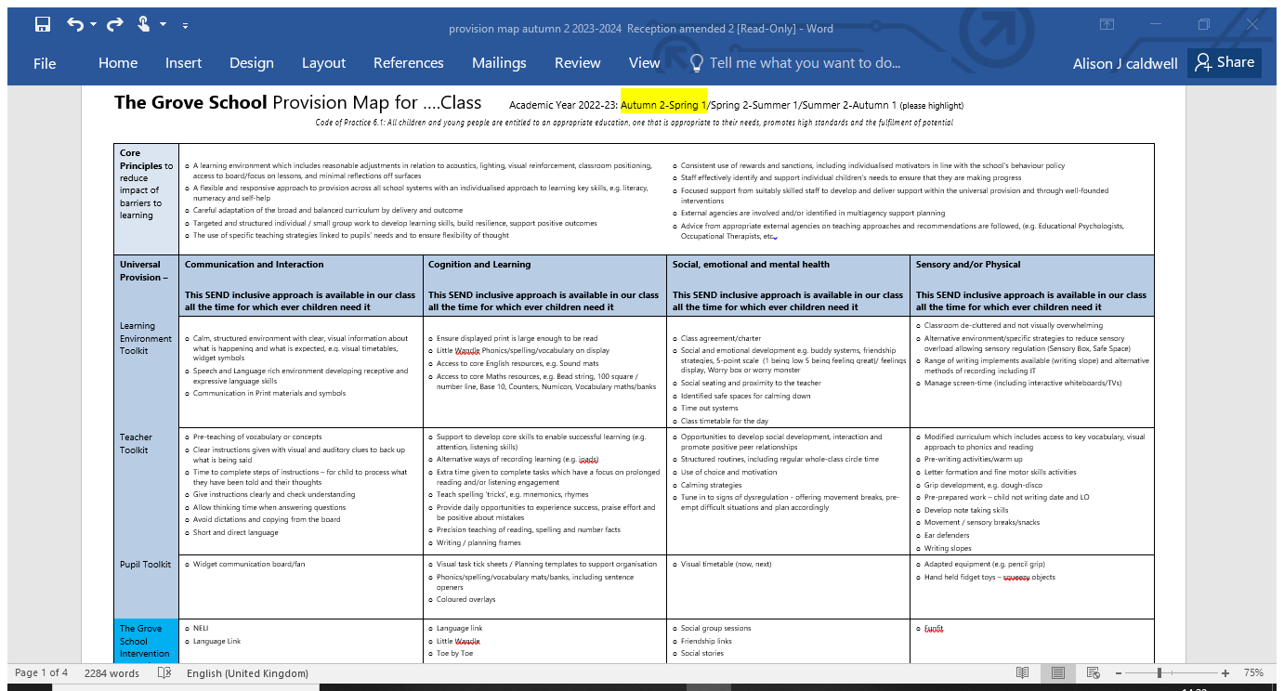
Notes:
Alison - Quality First Teaching guidance

Slide 17
Notes:
Alison - Quality First Teaching

Slide 18
Notes:
Tonya -This is an example of the targets for children who are on SEND register which we update x2 terms

Slide 19
Notes:
Alison – read a few examples. This is an example of targets for children on watch which the teacher is targeting

Slide 20
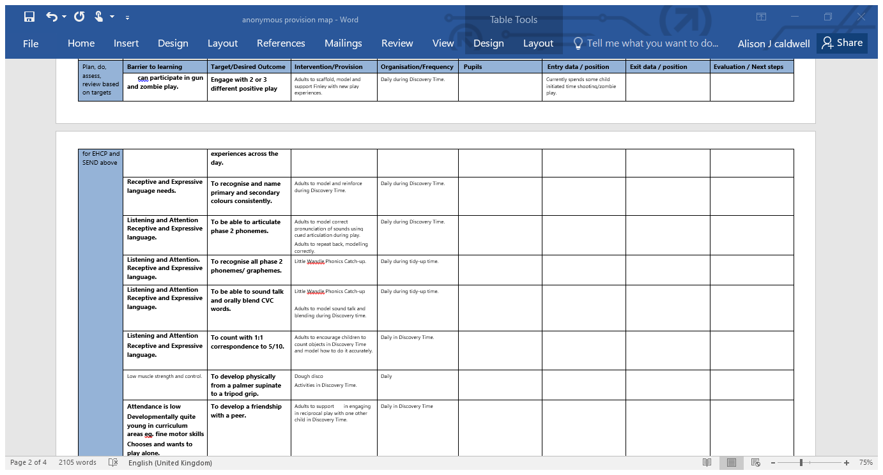
Notes:
Tonya – plan do review bit

Slide 21
How do we get in touch if we have a concern?
Firstly, speak to the class teacher about your concerns
The SENDco team is available by emailing:
sendco@the-grove-primary.devon.sch.uk
Devon Information and Advisory Service (DIAS) – this is an impartial and confidential telephone parent support service for parents who have children with special educational needs. They provide legally based and easily accessible information and advice about SEND
devonias.org.uk

Slide 22
How do we get in touch if we have a concern?
Firstly, speak to the class teacher about your concerns
The SENDCo team is available by emailing:
sendco@the-grove-primary.devon.sch.uk
Devon Information and Advisory Service (DIAS) – this is an impartial and confidential telephone parent support service for parents who have children with special educational needs. They provide legally based and easily accessible information and advice about SEND
devonias.org.uk
Notes:
Tonya

