Slide 1

SPEECH LANGUAGE & COMMUNICATION NEEDS

Slide 3
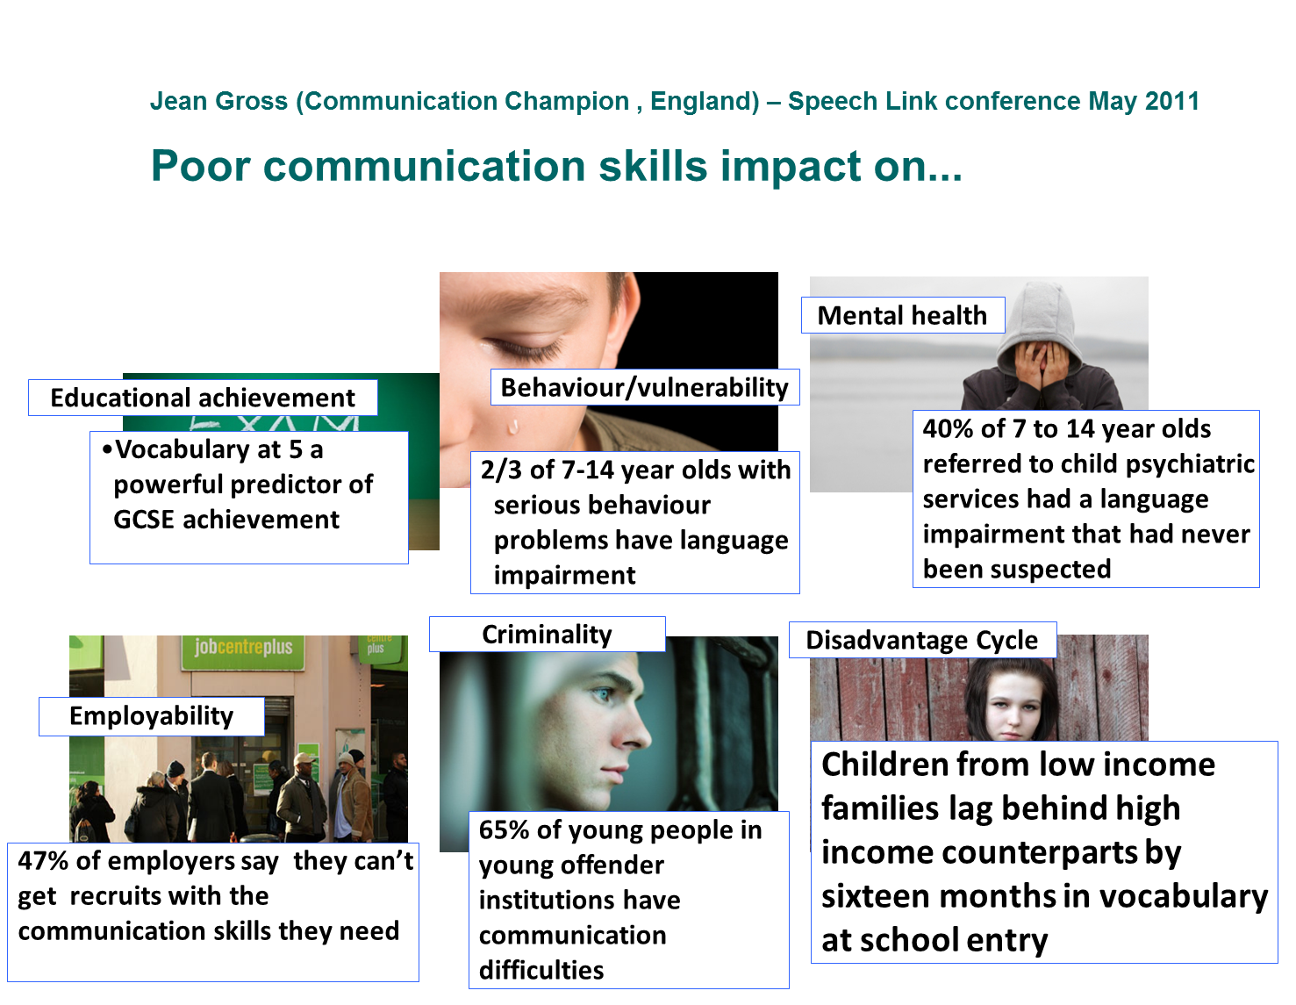
Impact of communication difficulties on CYP
Notes:
Ask staff to read and discuss.
3

Slide 4
To identify a speech, language and communication need we:
Screen all children as they enter Reception using an online programme called NELI.
For children we have greater concern about we use another online programme called Language Link – this assesses understanding of language
Teachers also use The Quick Needs Checker (below) as part of the referral process to the SENDCo
Communication and interaction There are concerns about…
the pupil’s attention and/or listening skills – their ability to engage successfully with language
the pupil’s receptive language – their ability to understand spoken language
the pupil’s expressive language – their ability to use language to communicate with others
the pupil’s speech sound development – their ability to produce the sounds necessary for clear, intelligible speech
the pupil’s social communications – their ability to use language appropriately and successfully in social situations
the pupil’s uneven learning profiles and learning styles i.e. they do not follow the usual developmental patterns
the pupil’s communication skills e.g. verbal and non-verbal, ability to recognise the feelings or perspectives of others and respond appropriately
the pupil’s social development e.g. capacity to ‘share interest’ and/or ‘share attention’
the pupil’s rigidity of thought e.g. ability to manage changes in routine
the pupil’s sensory skills e.g. over sensitivity or under sensitivity to sensory stimuli
the pupil’s cognitive development e.g. capacity to sustain concentration or self-direct their learning

Slide 5
Components of speech, language and communication
Speech
sounds
Social
Communi-cation
Language
Speech
Phonological Awareness
Vocabulary
Categories
Concepts
Phrases and sentences
Comprehension
Inference
Extended sentences
Turn taking
Friendship skills
Conversation skills
Notes:
Good model to decide what type/s of difficulty pupil has, what to work on

Slide 6
Receptive/Expressive Language
Receptive Language – ability to understand & comprehend spoken language you hear or read
Expressive Language – ability to communicate our thoughts and feelings through words gestures, signs/symbols (can be as simple as pointing to a desired object or as complex as writing a book

Slide 7

INPUT SKILLS
WORD STORE
OUTPUT SKILLS
segmentation
sound production
spelling
discrimination
feedback
Notes:
7
Language is a complex process – input and output skills involved
Good literacy requires efficient input skills so word is stored accurately, also has an impact on vocabulary development
Explain input skills
SALT often needed for output skills
Explain difference between slushy speech and sound substitution errors, when a SALT is needed
Links to speech processing
Explain poor representation, e.g. nana
7

Slide 8
Blank language levels
Level 1
Level 2
Level 3
Level 4
single words
phrases
factual sentences
inference
concrete abstract
vocabulary
concepts
explain
predict
Notes:
Blank Levels are an ideal way to assess and teach sentence understanding
Blank levels move from the concrete to the abstract and demonstrate the progression in verbal reasoning skills
Useful way to structure a teaching sequence – (1) topic vocabulary, e.g. types of rocks, (2) concepts and properties – practical experience with porous, permeable, rigid, (3) explaining what you are doing and (4) inferring what might/could/should happen.

Slide 9
Level One 2-3 years | Single word vocabulary | core nouns core verbs
Level Two 3-4 years | Phrases | concepts who, what, where categories, different
Level Three 4-5 years | Factual sentences | range of sentence types similarities negatives characters definitions how and when
Level Four 5+ | Inference | reasoning problem solving conditional verbs – would, could, should why
Notes:
Can give out poster provided at the training
9

Slide 10


Tiers of vocabulary
Tier 3: Subject terminology
Tier 2: Extended words
Tier 1: Core vocabulary
Subject specific words
Topic vocabulary
Book vocabulary
Wow words
Thinking verbs
Synonyms
Detail
Everyday vocabulary
Conversational
Common categories
(Beck, 2002)
Notes:
Cascade task for school
Research by Isabel Beck
T2 is the focus for attainment
Equates to medium frequency

Slide 11
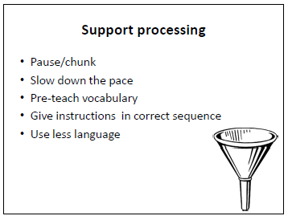

Slide 12
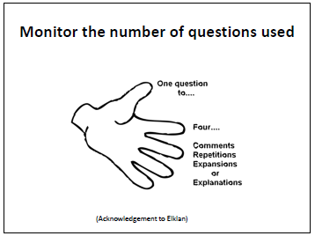

Slide 13
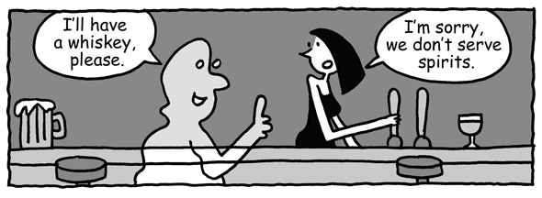
Social aspects of language
Understanding and using language to match different situations
Communication = what people say, mean, intend
Includes verbal and non-verbal communication
Notes:
(pragmatics)
Context is important because:
what we say is ambiguous
what we intend to communicate is not explicitly stated
Ambiguity
Intention
Children with pragmatic language impairment may say inappropriate or unrelated things during conversations or use unusual language and vocabulary. However, they can have age appropriate complexity of sentence construction and word structure and can appear to have fluent, complex and clearly articulated expressive language

Slide 14

Double click the black box below to watch the video

Slide 15
Being autistic does not mean you have an illness or disease
It means your brain works in a different way from other people.
Autism is not a medical condition with treatments or a "cure". Autism is a processing difference that can have an impact on many areas of a person’s life.
(AET website)

Slide 16

Autistic people will experience differences in three key areas:
Social Understanding and Communication
Autistic people have differences in the way they communicate, understand and use language. They engage in social life from a different perspective (Milton, 2011). This leads to differences in how the person interacts and develops relationships.
Sensory Processing and Integration
. Sensory differences can include hyper (high) or hypo (low) sensitivity in relation the eight senses of sight, hearing, touch, taste and smell, interoception (internal sensations), balance (vestibular) and body awareness (proprioception). These differences will vary from person to person and can actually fluctuate in their responsiveness depending on a number of different factors for example the time of day or the environment.
(AET website)

Slide 17
Flexible Thinking, Information Processing and Understanding
Autistic people have differences in their attention, interests and how they learn. This can include being very focused on particular interests. They have a different way of being flexible, so often feel safer and more comfortable with routines and structure as this lessens uncertainty.
While autistic people share these similar characteristics to some degree, they are also all different from each other. This is because autism is considered a spectrum. The autism spectrum is not linear from high to low but varies in every way that one person might vary from another.
There is no ‘typical’ autistic person. Every autistic individual has their own strengths, differences and needs, their own life journey and their own unique story. (AET website)

Slide 18
How do we support speech, language and communication needs in school?
Communication and Interaction This SEND inclusive approach is available in our class all the time for which ever children need it
Calm, structured environment with clear, visual information about what is happening and what is expected, e.g. visual timetables, widget symbols Speech and Language rich environment developing receptive and expressive language skills Communication in Print materials and symbols
Pre-teaching of vocabulary or concepts Clear instructions given with visual and auditory clues to back up what is being said Time to complete steps of instructions – for child to process what they have been told and their thoughts Give instructions clearly and check understanding Allow thinking time when answering questions Avoid dictations and copying from the board Short and direct language
Widget communication board/fan
NELI Language Link
EAL support Speech and Language support EHCP plan
Communication and Interaction Team Speech and Language Therapy Autism Assessment Pathway

Slide 19
Useful links
Referrals can be made to Speech and language services through school for concerns with speech, understanding of language and autism.
Parents can also complete their own referrals through the Single Point of Access (SPA) - https://childrenandfamilyhealthdevon.nhs.uk
There are a range of useful videos to support parents with suggestions of how to help their children with communication skills
https://childrenandfamilyhealthdevon.nhs.uk/slt/how-to-videos/#earlycomms
Autism Education Trust – www.autismedcuationtrust.org.uk – this website has a lot of useful resources and information

