Slide 1
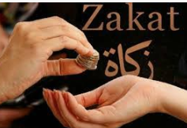
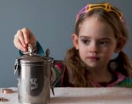
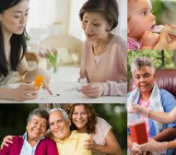
Thematic : KS1 Knowledge Mat (1.9 Y1)
Subject Specific Vocabulary
Unique | One of a kind – YOU are unique!
Friends | Someone you know well and you like and likes you.
Zakah (Islam) | Giving to charity.
 |  | Sticky Knowledge- How should we care for the world and for others, and why does it matter? | Exciting Books
Tzedaka (Judaism) | Giving to charity.
Golden Rule | Lots of religions follow this rule – Love God and love one another.
 |  | Christians and Jews believe that God values everyone. Christians and Jews believe that God created the earth and everything on it.
 |  | In the Bible there are lots of stories about friendship and caring for others, for example The Good Samaritan (Luke 10:25-37) Ruth and Naomi.
 |  | The Story of Creation tells Christians and Jews that they have a role to look after the earth and everything on. It is important to look after one another.

