Slide 1

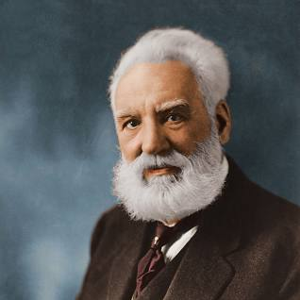

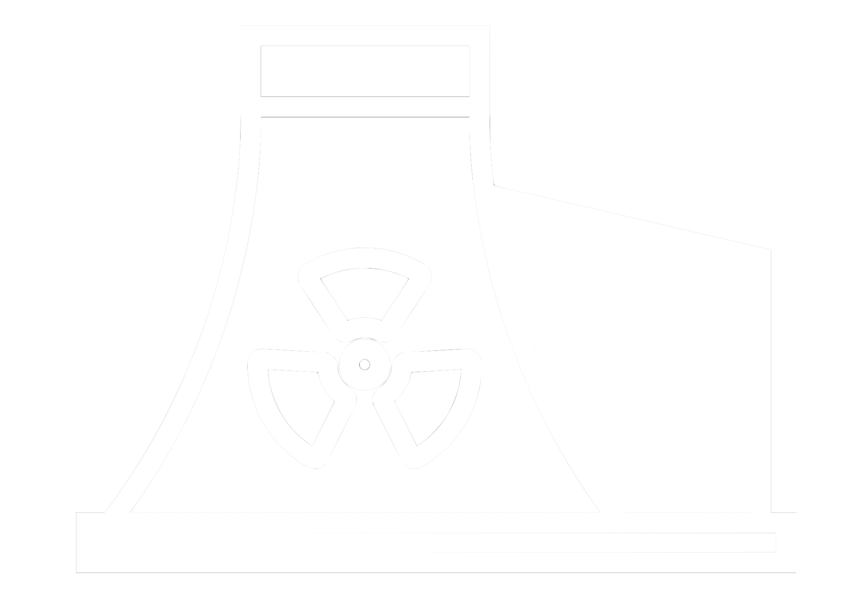








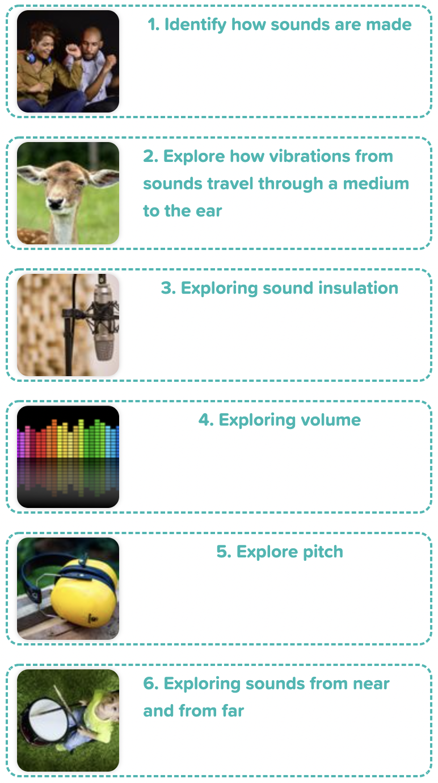
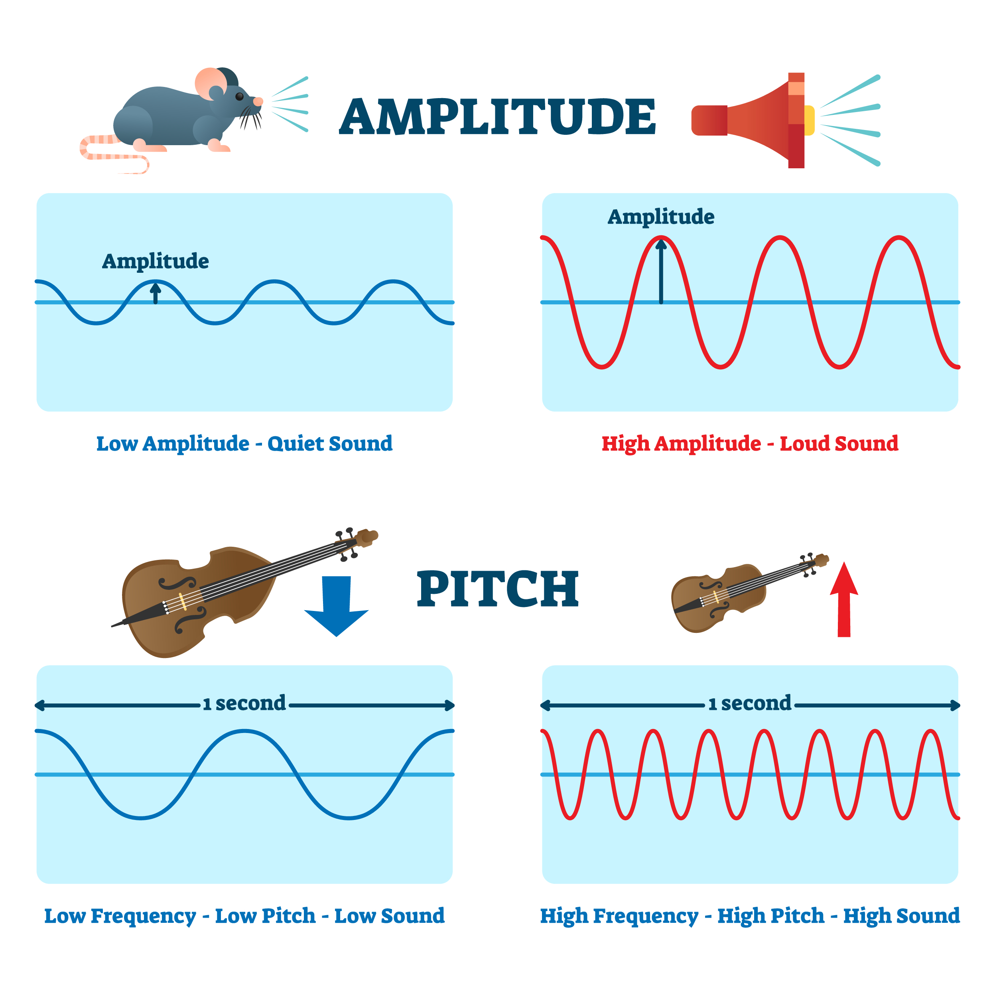
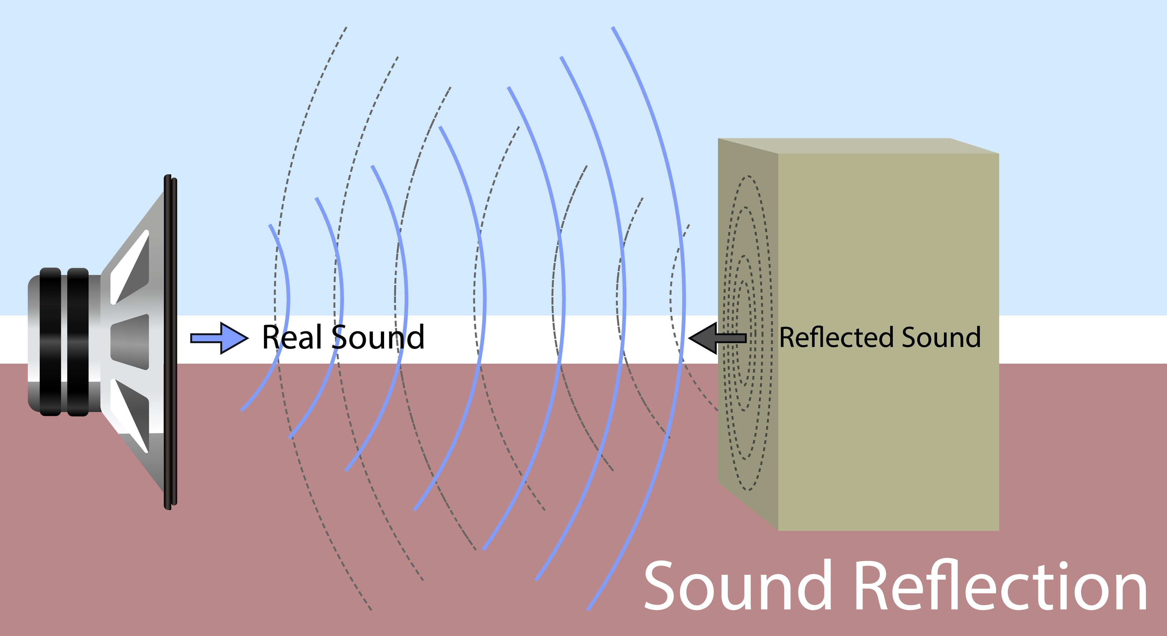
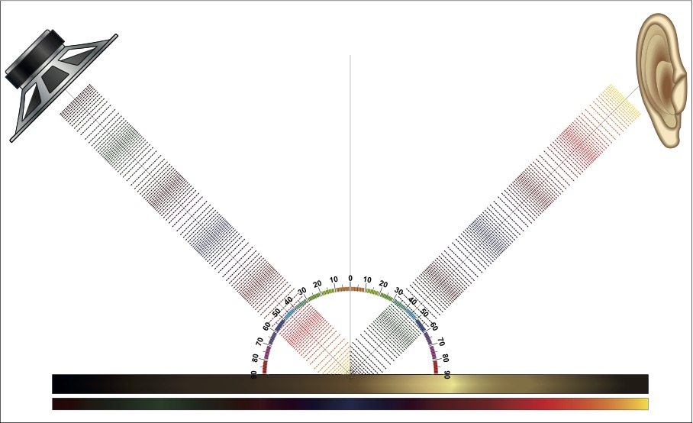
Careers connected to sound:
audiologist, sound engineer
Focus Scientist: Alexander Graham Bell
Knowledge Organiser: Sound
Careers connected to the human body:
doctor, nurse, massage therapist, personal trainer, theatre technician
Pitch
How sounds are made and travel
The pitch of a sound is how high or low it is. A squeak of mouse has a high pitch A roar of a lion has a low pitch.
A high pitch sound is made because it has a high frequency. The sound source vibrates many times a second.
Knowledge Sequence
When objects vibrate, a sound is made. The vibration makes the air around the object vibrate and the air vibrations enter your ear. These are called sound waves. If an object is making a sound, a part of it is vibrating, even if you cannot see the vibrations. Sound waves travel through a medium (such as air, water, glass, stone, and brick).
1. Identify how sound is made
2. How do we hear sound? Explore how vibrations from sounds travel through a medium to the ear
3. Explore how vibrations from sounds travel through a medium to the ear
Volume
The volume of a sound is how loud or quiet it is. Quieter sounds have a smaller amplitude and less energy (smaller vibrations) and louder sounds have a bigger amplitude and more energy. The closer we are to a sound source the louder it will be. A train arriving at a station sounds loud. The further away from a sound the fainter it will be. A train in the distance sounds quieter.
4. Explore Key Scientist – Alexander Graham Bell
How do we hear?
The sound waves travel to the ear and make the eardrums vibrate. Messages are sent to the brain which recognises the vibrations as sounds.
5. Explore volume
6. Explore pitch
Developing Experts Copyright 2022 All Rights Reserved

Slide 2


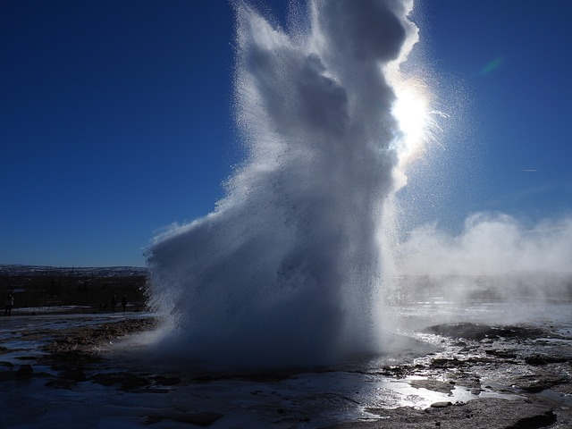
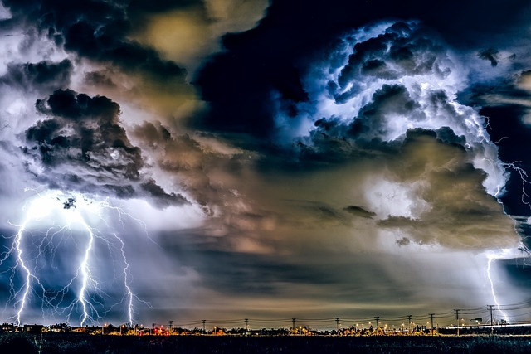


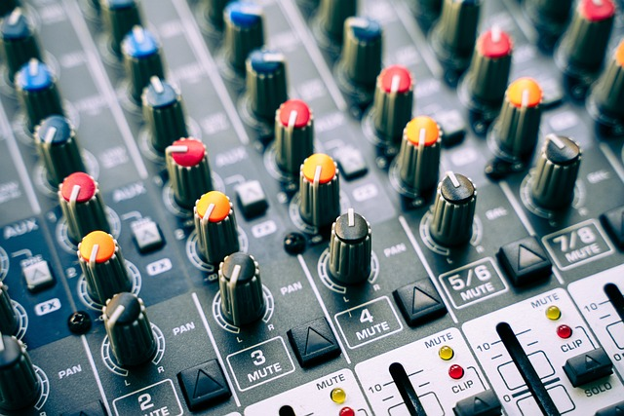
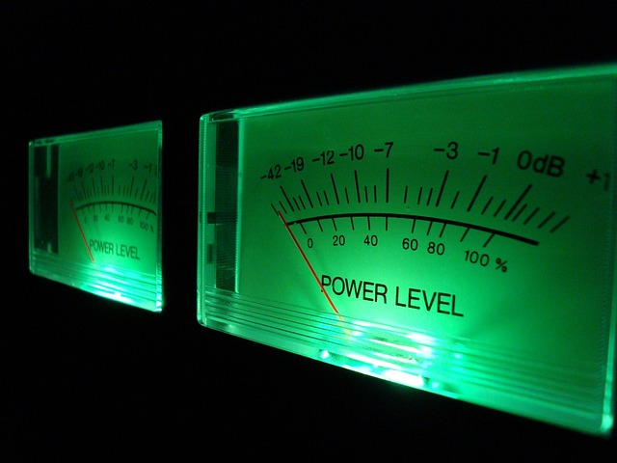


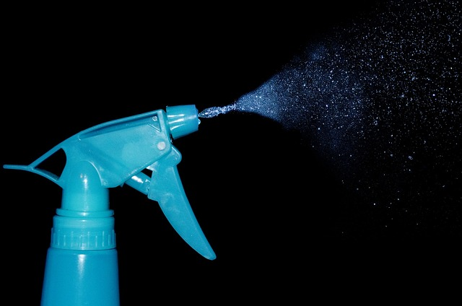
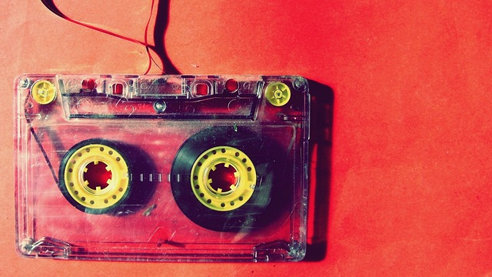
Key Vocabulary: Sound
Careers connected to the human body:
doctor, nurse, massage therapist, personal trainer, theatre technician
Rocket Words
 | Vibration | Particles moving very quickly
 | Medium | A substance such as air, water or a solid
 | Source | The start of something
 | Energy | The power to make something work, move or grow
 | Materials | Anything used in making something or building
 | Reflect | Bounce back from a surface
 | Volume | How loud or quiet a sound is
 | Decibels | The unit to measure loudness
 | Pitch | How high or low a sound is
 | Instruments | Objects used to play music
 | Particles | Tiny pieces that make up something larger
 | Sound source | The object that started the sound
Developing Experts Copyright 2022 All Rights Reserved

