Slide 1
WORKSHOP DETAILS
Practitioner Information Page – NOT to be shared in session
Intended audience: CYP aged 11-18
Method of delivery: Remote or face-to-face
Number of sessions: 1
Duration:
Number of facilitators required: At least 2
School requirements: If f-2-f, projector an
Materials required:

Slide 2
MHST Introduction to The Grove
Who are we?
Notes:
Karola - 1 minute

Slide 3
Who the MHST are
Notes:
Karola – introduce MHST, explain we are linked with NHS and what some of these logos mean – 2 mins

Slide 4
What is mental health?
Notes:
Karola – explanation of what mental health is, compare it to physical health, could think about it as a scale? Up to 5 mins

Slide 5
MHST – What we do
We support schools to develop their Whole School Approach to their Mental Health Provision through:
- Student workshops & Participation events
- School Staff Workshops
- Mental Health Ambassadors + Training
- Mental Health Strategy
- Staff Support: Consultation and Time to Reflect
- Parent Workshops
Notes:
Pam – explain support we offer to schools – 2mins

Slide 6
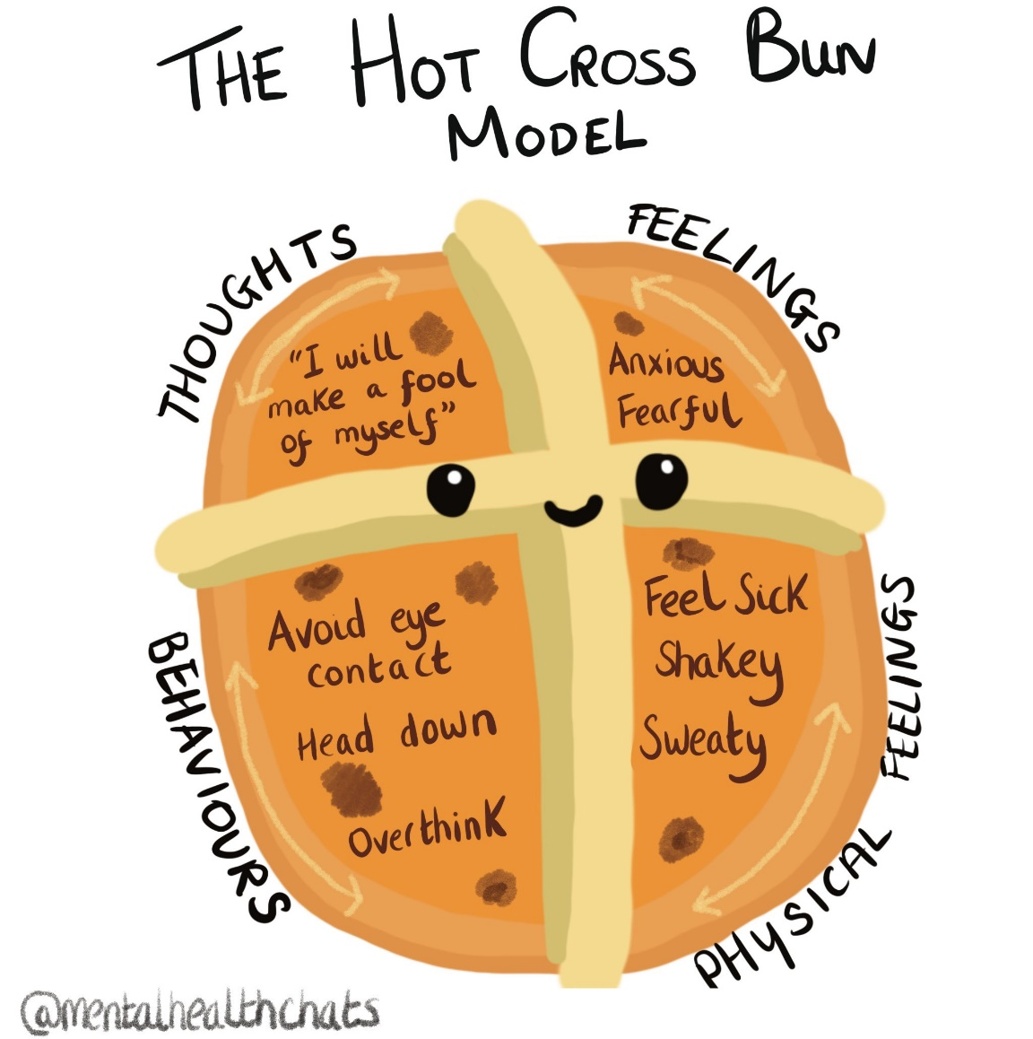
What we do
Low Intensity
Cognitive Behavioural Therapy (LI-CBT) for:
Worries
Fears and phobias
OCD
Panic
Managing emotions
Might be with you, with parents/carers, or with both!
Notes:
Pam – explain support we can offer 1-1, that it might be with young person, with parents or with both. Maybe go through an example of a hot cross bun of someone feeling worried? – up to 5 mins

Slide 7
Children’s Experience of MHST
Mental Health Support Team (MHST) - short version - YouTube
Notes:
Pam – introduce video 3 mins

Slide 8
How do you access MHST?
If you feel you would like some support with your mental health from the MHST, you can:
- Speak with your Mental Health Team or Teachers about your concerns, who can then pass on this information (anonymously at this point) to us.
Notes:
Karola – explain we will be working with the school-2 mins

Slide 9
The 10 a day choices towards balancing our mental health
Notes:
Karola - Will confirm how much time we have and take this out if its too much. Could to hands up for who has done this, this week? Examples of how we can do these? Compare to 5 fruit and veg a day and that we don’t need to hit all everyday? – up to 5 mins but can make really brief or draw out depending on time

Slide 10
Resources
CAMHS Out of Hours: 0300 555 5000
This number is active 7 days a week, 5pm – 9am on weekdays and 24 hours on weekends.
Pastoral Support in School
Notes:
Pam – signpost to helpful resources. Explain who young people can go to in school if they want to know more – 2 mins

Slide 11
See you soon!
Notes:
Pam – thank students for their time – 1 min

