Slide 1
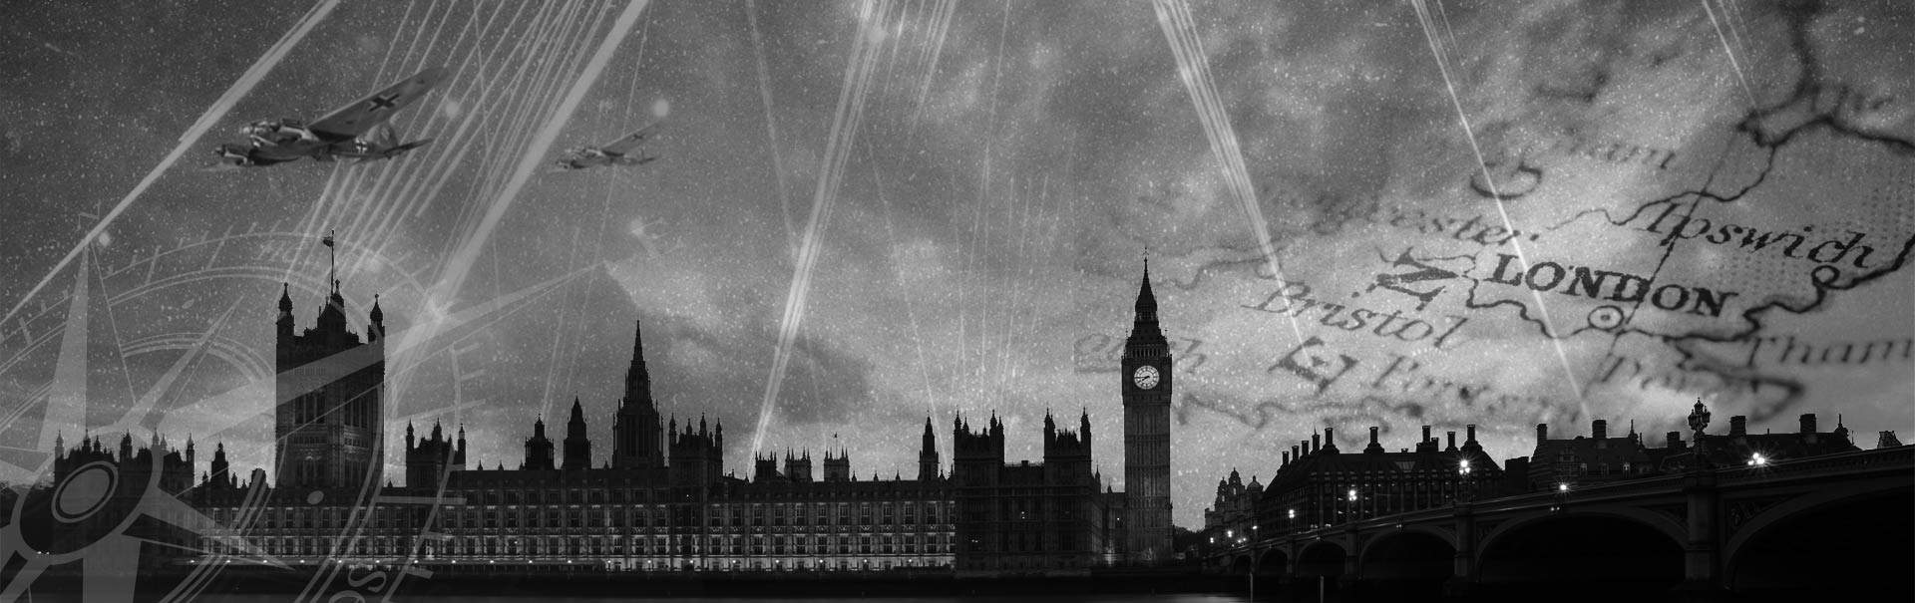
WW2 timeline
By Finley Atkins

Slide 2
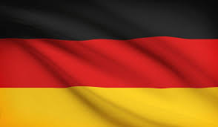
1939
September 1st 1939 - Germany Invades Poland.
September 3rd 1939 – GB, France, Australia and NZ declare war on Germany.

Slide 3
1940
April 1940 – Germany invades Norway and Denmark.
May 1940 – Germany invades the Netherlands, Belgium and Luxembourg.
May 10 – Winston Churchill became Prime Minister.
June 1940 – Germany invades and conquers France.

Slide 4
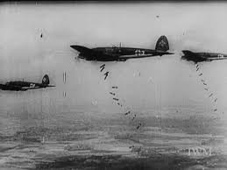

The bombing of London
September 1940 – Germany begins bombing London.
They bombed London every night, for 57 nights, killing more than 40,000 people. It was a tragic time back then.

Slide 5
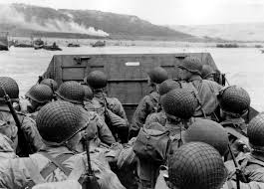
June 6th 1944
D-day – Normandy landings

Slide 6

May 7th 1945
Germany surrenders…
Victory!!

Slide 7

August 14th 1945
End of WW2

